Slide 1



DIRECTV – IBM EFFORT ANALYSIS
2016-CAC2 (2/13/2016 to 4/8/2016)
V1.0 DRAFT

Slide 2
2016-CAC2 (2/13/2016 to 4/8/2016)
Effort Comparison across CAC, PTS and Actual
A quick high level comparison of CAC estimated hours, PTS hours vs Actual
However we came over by 3960 when compared to PTS hours
We came under by 3461 hours when compared to CAC estimation (Next Slide show as where 3461 hours was spent)
Application | CAC Estimated | Planned (PTS) | Actual | Difference Between CAC and Actual | Difference Between PTS and Actual
BPT | 1047 | 641 | 1401 | 354 | 760
C3 | 3030 | 1965 | 1978.5 | -1051.5 | 13.5
Directv.com | 749 | 180 | 508 | -241 | 328
DWS | 597 | 102 | 128.5 | -468.5 | 26.5
EI | 2396 | 918 | 2218 | -178 | 1300
FS Scheduler | 476 | 40 | 267 | -209 | 227
IVR | 446 | 592 | 458 | 12 | -134
OM | 922 | 300 | 970.5 | 48.5 | 670.5
RIO CC | 790 | 436 | 788.5 | -1.5 | 352.5
RIO FSS | 684 | 338 | 656 | -28 | 318
RIO LTE | 204 | 164 | 15.5 | -188.5 | -148.5
STMS | 1431 | 410 | 724.5 | -706.5 | 314.5
TAOS | 1234 | 1147 | 1083.5 | -150.5 | -63.5
TCS | 130 | 0 | 56 | -74 | 56
Test Data Management | 2630 | 2111 | 2051 | -579 | -60
Total | 16766 | 9344 | 13304.5 | -3461.5 | 3960.5
Notes:
OS: remove OS > OMS/OC to OM
April 25, 2015 : Joy > quality framework

Slide 3
2016-CAC2 (2/13/2016 to 4/8/2016)
Effort spent on additional capacity
Of the 3461 additional hours that was reserved during CAC is spent across below areas and counting until 4/8
Application | Enablement | Initiatives | Process | Test Accelerators | Idle Time | Grand Total
BPT | 76 | 103.5 | 28 | 1 | 6.5 | 215
C3 | 159.5 | 28 | 30 |  |  | 217.5
Directv.com | 261.5 |  | 13 | 1 | 2.5 | 278
DWS | 111 | 109.5 | 40.5 | 77 |  | 338
EI | 132 | 21 | 6.5 |  |  | 159.5
FS Scheduler | 100.5 |  | 18 |  |  | 118.5
IVR | 328 | 224 | 5 |  |  | 557
OM | 98 | 425.5 | 92 | 47 | 65.5 | 728
RIO CC | 176 | 40.5 | 29 | 38 | 2 | 285.5
RIO FSS | 55 |  | 46.5 | 2 |  | 103.5
RIO LTE |  |  | 1 |  |  | 1
STMS | 71 | 89.5 | 34.5 |  |  | 195
TAOS | 50.5 | 70.5 | 26.5 |  | 12 | 159.5
TCS | 11 | 2 | 3.5 |  | 6 | 22.5
Test Data Management | 331 | 54.5 | 20 |  | 8 | 413.5
Grand Total | 1961 | 1168.5 | 394 | 166 | 102.5 | 3792
Notes:
OS: remove OS > OMS/OC to OM
April 25, 2015 : Joy > quality framework

Slide 4
2016-CAC2 (2/13/2016 to 4/8/2016)
Effort spent on additional capacity
Of the 3461 additional hours that was reserved during CAC is spent across below areas and counting until 4/8
Application | Enablement | Idle Time | Initiatives | Process | Test Accelerators | Time Off/Holiday | Grand Total
BPT | 76 | 6.5 | 103.5 | 28 | 1 | 130.5 | 345.5
C3 | 159.5 |  | 28 | 30 |  | 145.5 | 363
Directv.com | 261.5 | 2.5 |  | 13 | 1 | 48 | 326
DWS | 111 |  | 109.5 | 40.5 | 77 | 18 | 356
EI | 132 |  | 21 | 6.5 |  | 279 | 438.5
FS Scheduler | 100.5 |  |  | 18 |  | 27 | 145.5
IVR | 328 |  | 224 | 5 |  | 16 | 573
OM | 98 | 65.5 | 425.5 | 92 | 47 | 64 | 792
RIO CC | 176 | 2 | 40.5 | 29 | 38 | 49.5 | 335
RIO FSS | 55 |  |  | 46.5 | 2 | 33.5 | 137
RIO LTE |  |  |  | 1 |  |  | 1
STMS | 71 |  | 89.5 | 34.5 |  | 57 | 252
TAOS | 50.5 | 12 | 70.5 | 26.5 |  | 108 | 267.5
TCS | 11 | 6 | 2 | 3.5 |  |  | 22.5
Test Data Management | 331 | 8 | 54.5 | 20 |  | 51 | 464.5
Grand Total | 1961 | 102.5 | 1168.5 | 394 | 166 | 1027 | 4819
Notes:
OS: remove OS > OMS/OC to OM
April 25, 2015 : Joy > quality framework

Slide 5
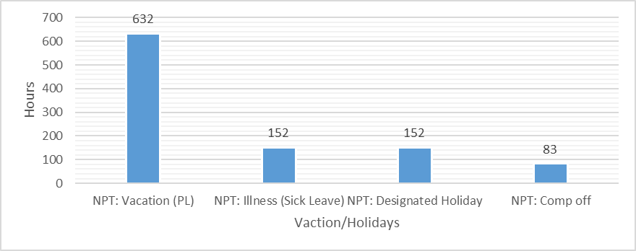
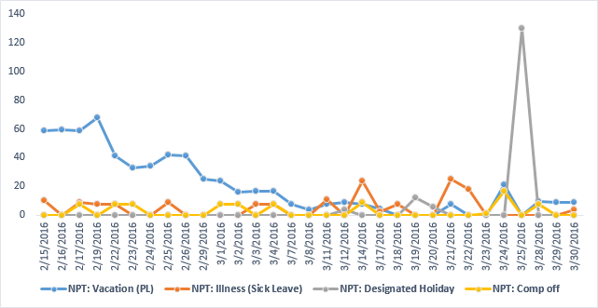
2016-CAC2 (2/13/2016 to 4/8/2016)
Vacation/Holidays
Vacation/Holidays
Vacation/Holidays | Total Hours
Vacation (PL) | 632
Illness (Sick Leave) | 152
Designated Holiday | 152
Comp off | 83
Grand Total | 1019
*NPT: Non Project Task
Good Friday Holiday for both Brazil and India
Over 419 hours of project work delivered as part of holiday coverage
Vacations are high during low demand period or before Enterprise release can start
*NPT: Non Project Task
Notes:
OS: remove OS > OMS/OC to OM
April 25, 2015 : Joy > quality framework

Slide 6
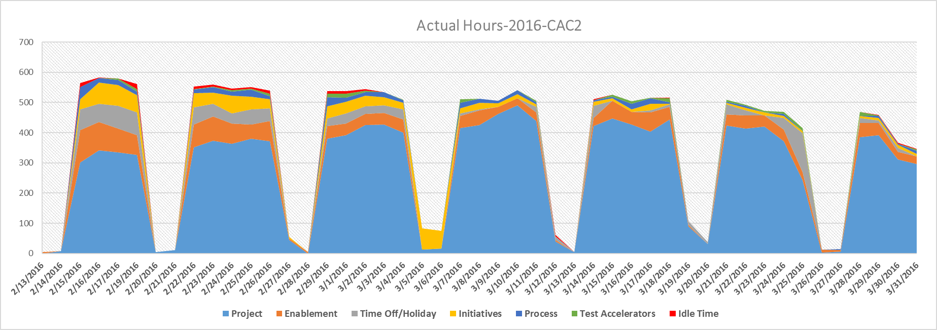
2016-CAC2 (2/13/2016 to 4/8/2016)
Effort Comparison across CAC, PTS and Actual
Quick overview of daily burn rate across main activities during CAC1-2016 period
Notes:
OS: remove OS > OMS/OC to OM
April 25, 2015 : Joy > quality framework

Slide 7
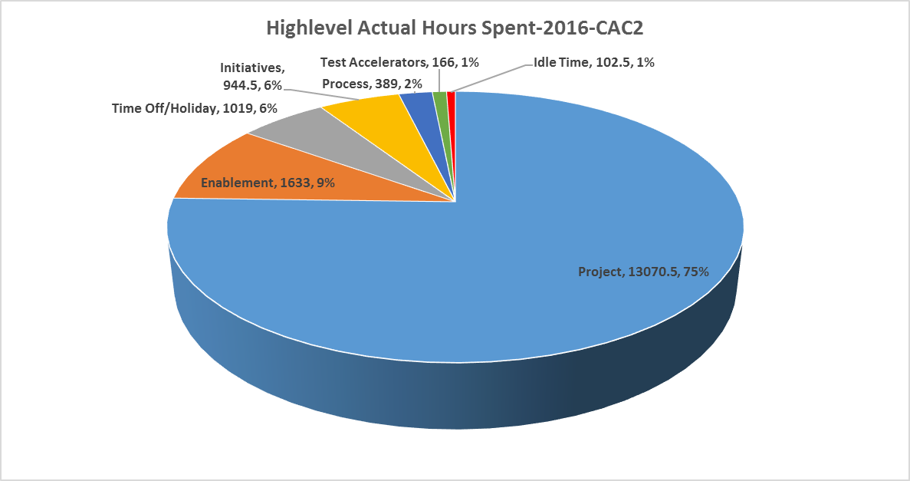
2016-CAC2 (2/13/2016 to 4/8/2016)
High level Actual Hours distribution
Distribution of main activities during CAC1-2016 period
Notes:
OS: remove OS > OMS/OC to OM
April 25, 2015 : Joy > quality framework

Slide 8
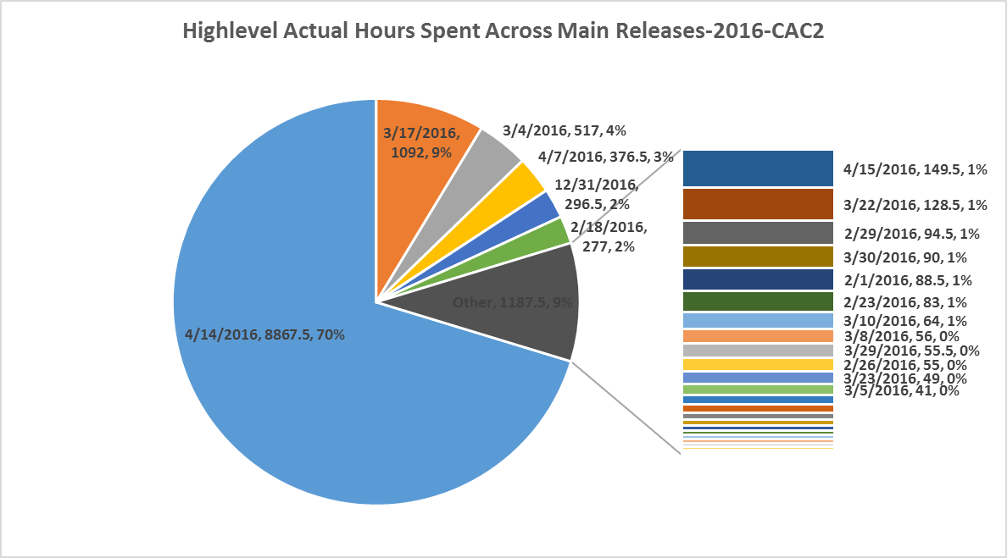
2016-CAC2 (2/13/2016 to 4/8/2016)
High level Actual Hours Across Main Releases
Notes:
OS: remove OS > OMS/OC to OM
April 25, 2015 : Joy > quality framework

